Slide 1
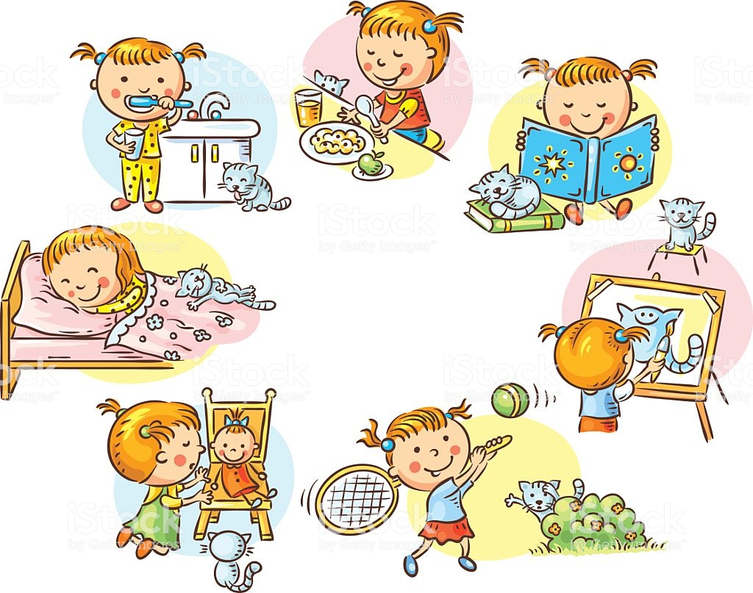
What did she do yesterday?

Slide 2
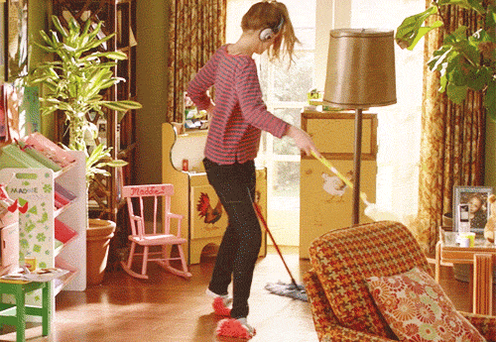
cleaned the room
clean the room
〔d〕

Slide 3
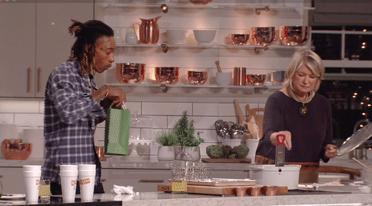
cooked dinner
cook dinner
〔t〕

Slide 4
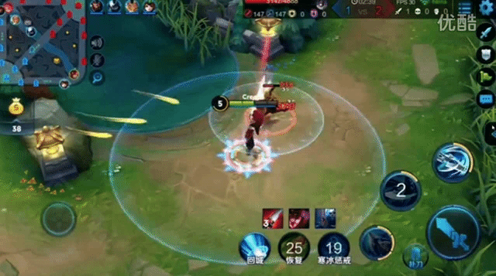
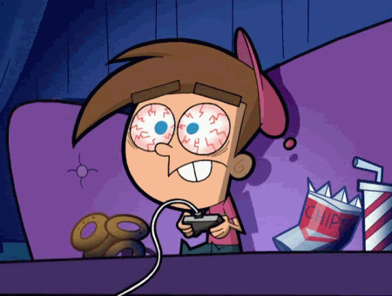
play on-line games
played on-line games
〔d〕

Slide 5
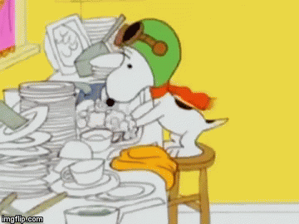
washed the dishes
wash the dishes
〔t〕

Slide 6
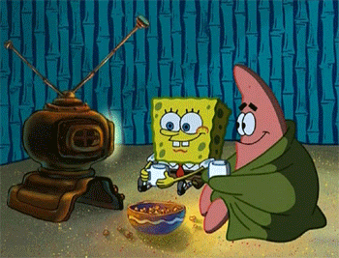
watch a movie
watched a movie
〔t〕

Slide 7
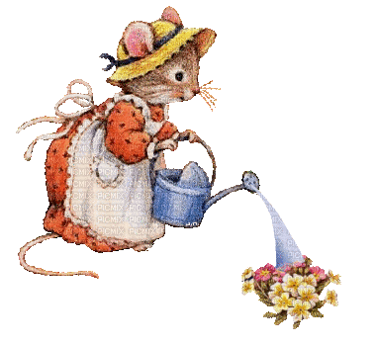
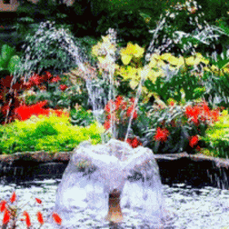
water the flowers
watered the flowers
〔d〕

Slide 8
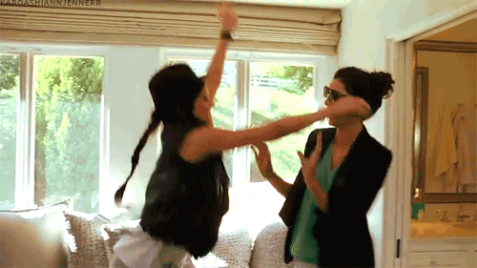
visit a friend
visited a friend
〔Id〕

Slide 9
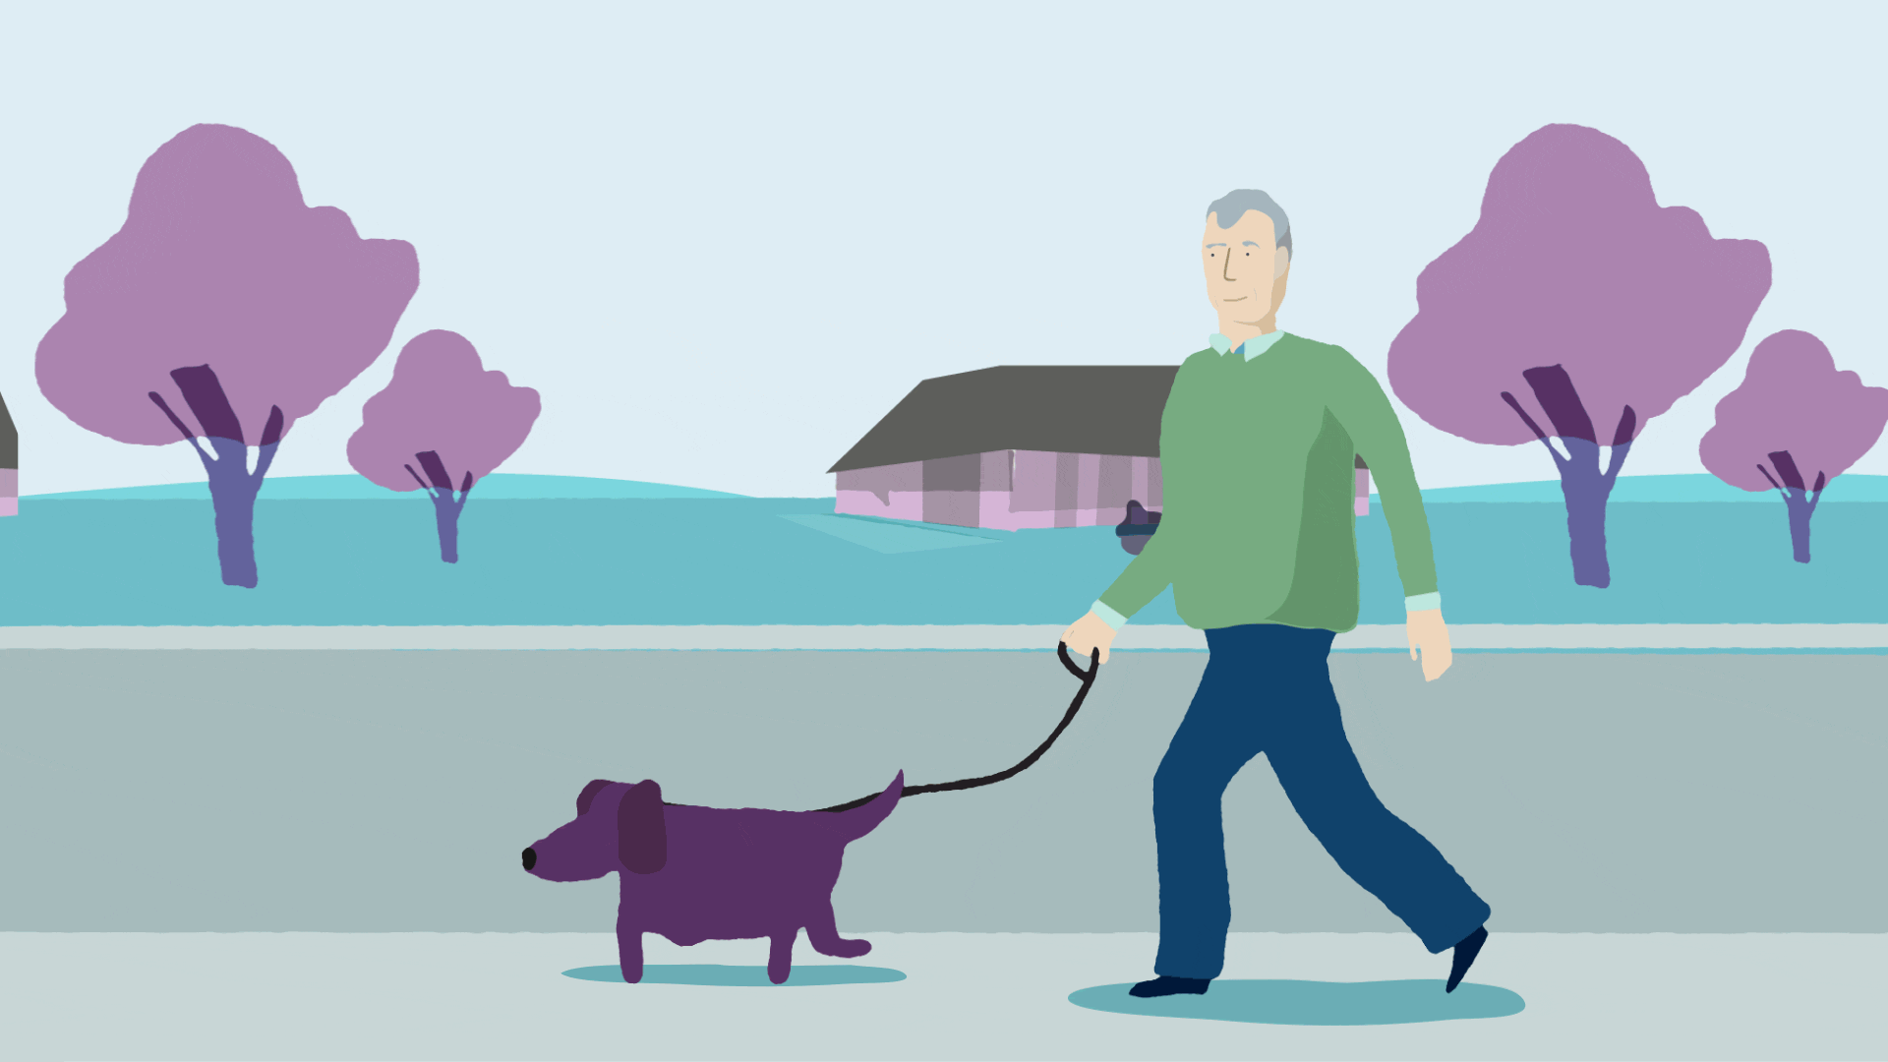
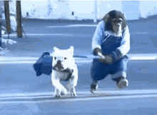
walked the dog
walk the dog
〔t〕

Slide 10
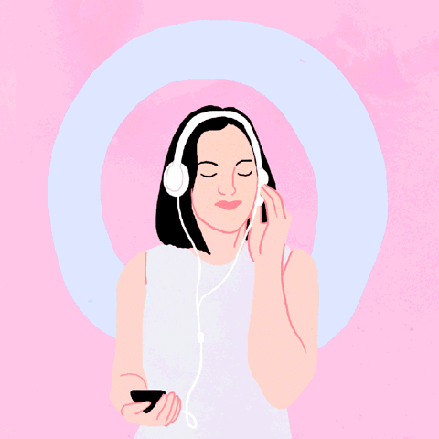
listened to music
listen to music
〔d〕

Slide 11
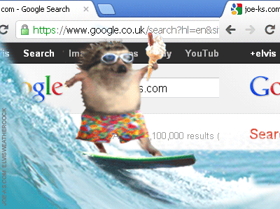
surfed the Internet
surf the Internet
〔t〕

Slide 12
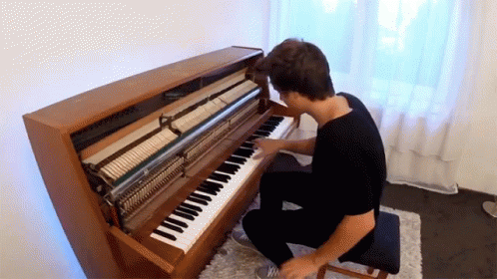
played the piano
play the piano
〔d〕

Slide 13
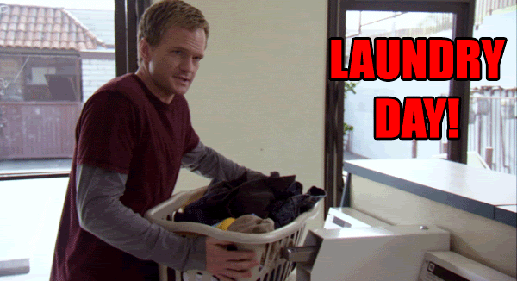
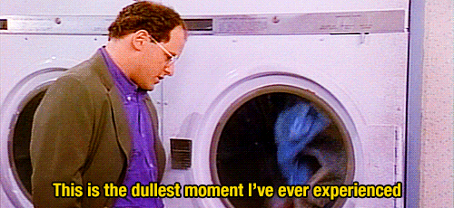
did the laundry
do the laundry

Slide 14
Did you clean the room yesterday?
過去式助動詞
照妖鏡→ 把動詞打回原形
cleaned → clean

Slide 15
Did you surf the Internet yesterday?
Yes, I did.
I surfed the Internet yesterday.

Slide 16
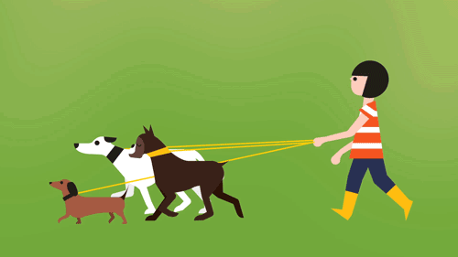
Did she wash the dishes last night?
No, she didn’t.
She walked the dogs last night.

Slide 17
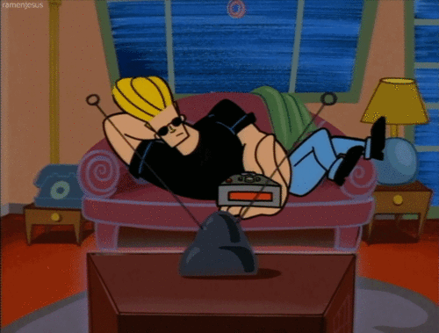
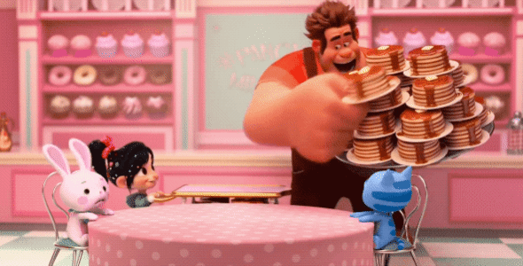
Did he watch a movie last Friday?
Yes, he did.
He watched a movie last Friday.

Slide 18
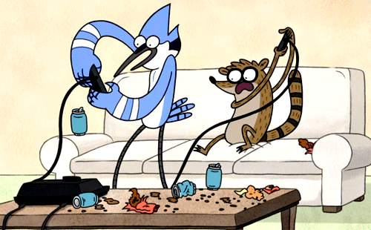
Did they do their homework last weekend?
No, they didn’t.
They played on-line games last weekend.

Slide 19
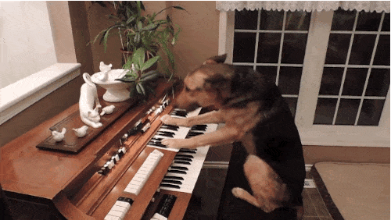
Did the dog play the piano yesterday morning?
Yes, it did.
It played the piano yesterday morning.

Slide 20
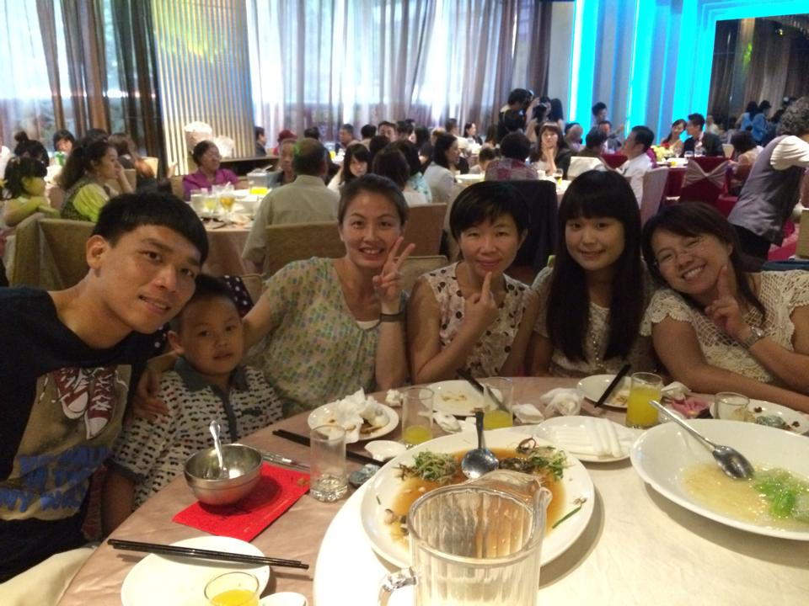
Did Mandy cook dinner last year?
No, she didn’t.
She visited her friends last year.

Slide 21
listen to music
water the flowers
watch a movie

Slide 23
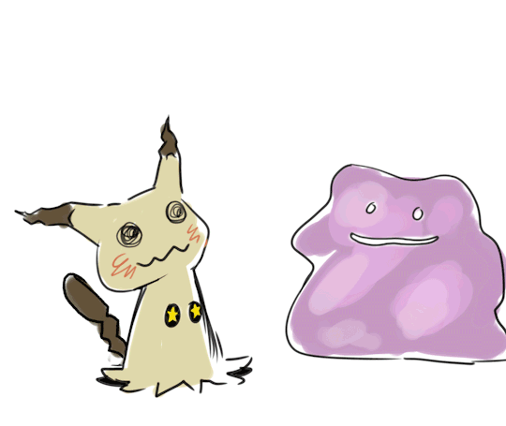
【本週英語作業】
1.聽:CD2 Unit 4全。
2.寫:完成英習P34~P35
(P35句型要詳答)。
3.挑戰Quizlet單字句型篇。

Slide 24
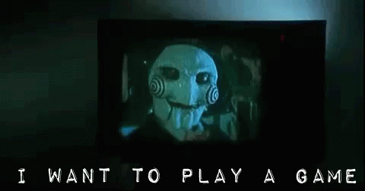

Slide 25
cleaned the room
cooked dinner
played on-line games
washed the dishes
watched a movie
watered the flowers
visited a friend
walked the dog
listened to music
surfed the Internet
★played the piano★
did the laundry

Slide 26
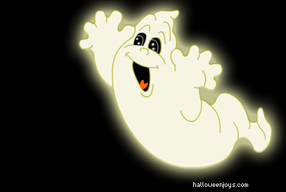
Catch the ghost!

Slide 27
1. Everybody gets a number and takes turns to go outside.
2. Use the sentence “What did you do last night?” to ask classmates.
3. Try to find out who says the answer “ I played the piano.”.
4. In the class, only the ghost can use “played the piano”. The other students should use another 11 activities.
5. The person who catches the ghost can get 1 point.
If you’ve already caught the ghost, you should stop.
6. The ghost can survive after 10 secs will get 2 points.

Slide 29
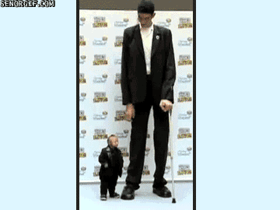
short
Chandra is _____,
but Sultan is _____.
tall

Slide 30
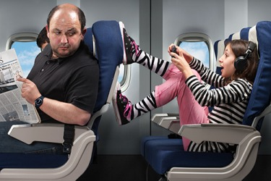
rude
The girl is _____,
but the woman is _____.
polite

Slide 31
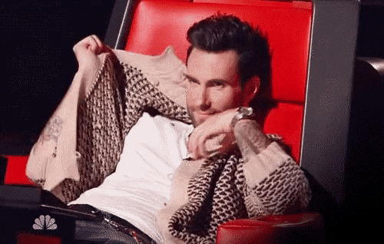
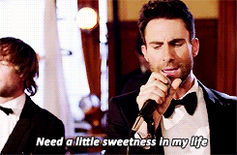
shy
Sometimes Adam Levine is _____,
but he is usually an _____ man.
outgoing

Slide 32
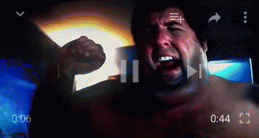
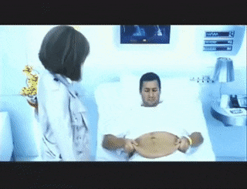
heavy
He was _____ before, but he is _____ now.
thin

Slide 33
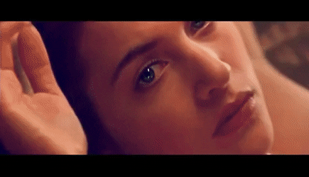
young
She was _____ before,
but she is _____ now.
old

Slide 34
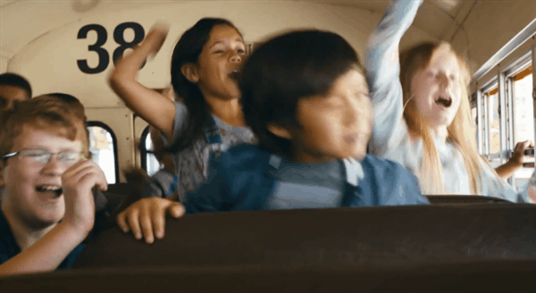
noisy
The kids were _____ before,
but they are _____ now.
quiet

Slide 35
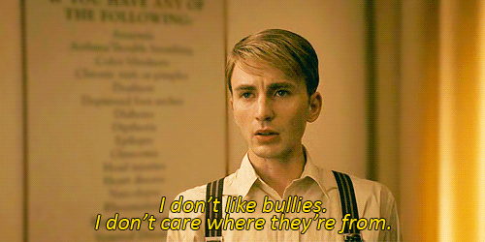
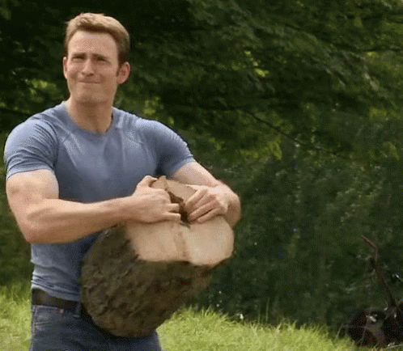
weak
Steve Rogers was _____ before,
but he is _____ now.
strong

Slide 36
messy
The room was _____ before,
but it is _____ now.
neat

Slide 37
錯的單字10遍
P14~P17錯的5遍
P32~P35錯的3遍

